Slide 1

Path-finding Visualizer
By Emmanuel olaoye

Slide 2
IN this Presentation
What my project is about
Background Research
Minimum Viable Product (MVP)
Finished Product

Slide 3
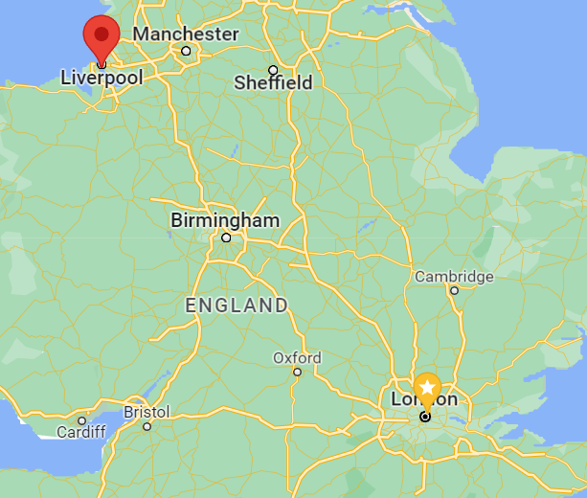
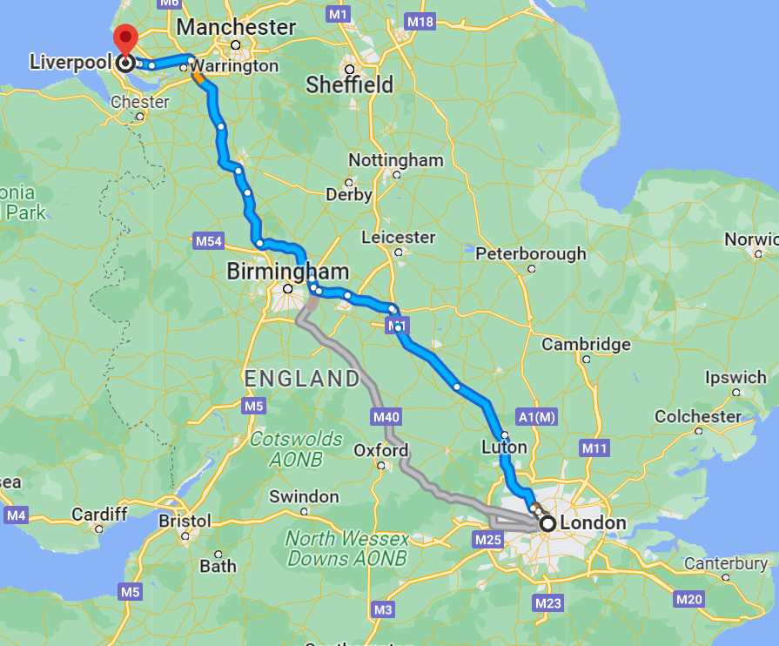
What is Pathfinding

Slide 4
What is Pathfinding
Pathfinding or pathing is the plotting, by a computer application, of the shortest route between two points.
Finding the Shortest path
Common algorithms include - Greedy, Dijkstra's algorithm, and A* , Bfs, Covariant , Bidirectional
This Project will use Dijkstra's Algorithm

Slide 5
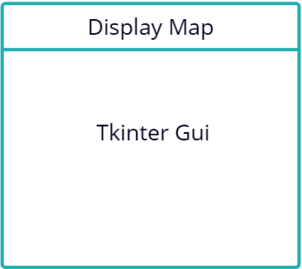
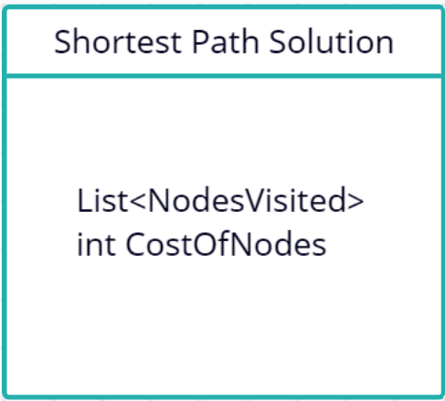
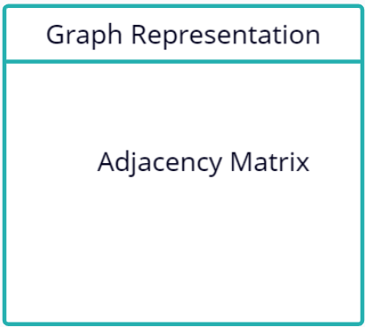
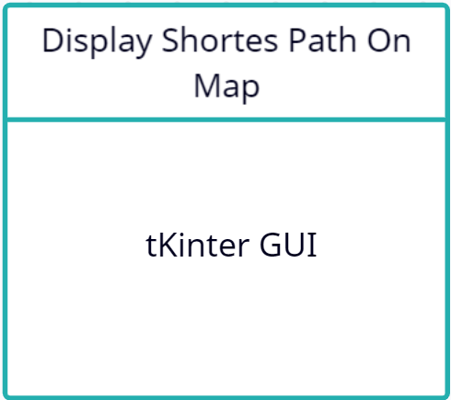
Use diagram from meeting
Run Dijkstra's Algorithm
Recognize intersections and roads
Translate Back To Map

Slide 6
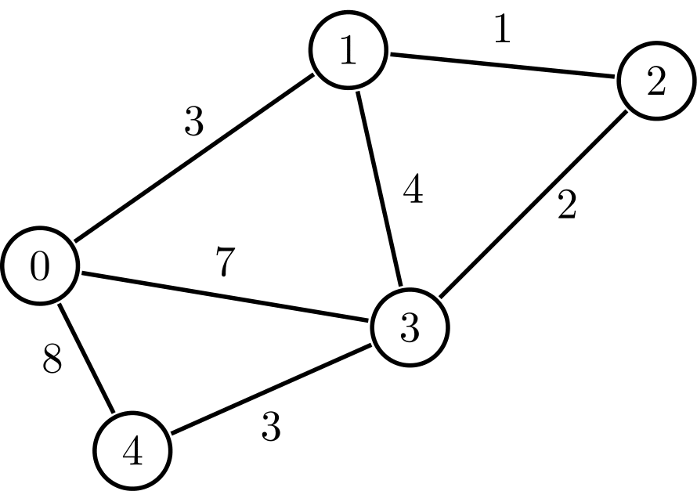
Dykstra's algorithm
It was conceived by computer scientist Edsger W. Dijkstra in 1956
Guarantees the shortest path
One of the most used algorithms
Doesn’t Require use all edges
(when on a node only need neighbors )

Slide 7
What is in my MVP
Developed using Python
10 weeks of development
Mainly Terminal Based
Has Dijkstra's Algorithim fully implemented
With the shortest path between any given origin and destination

Slide 8
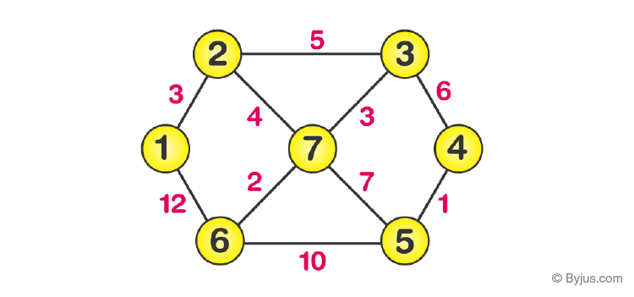
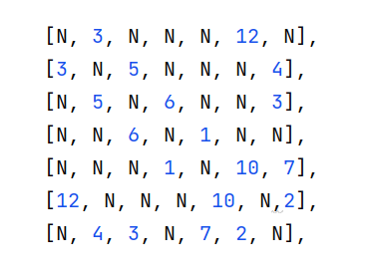
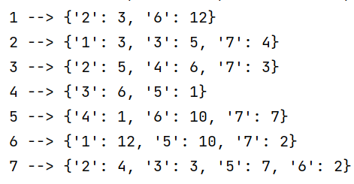
What is in my Mvp
User enters start and destination

Slide 9
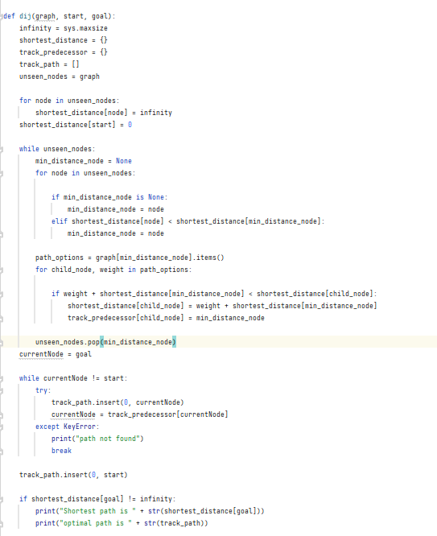

Getting the shortest path

Slide 10
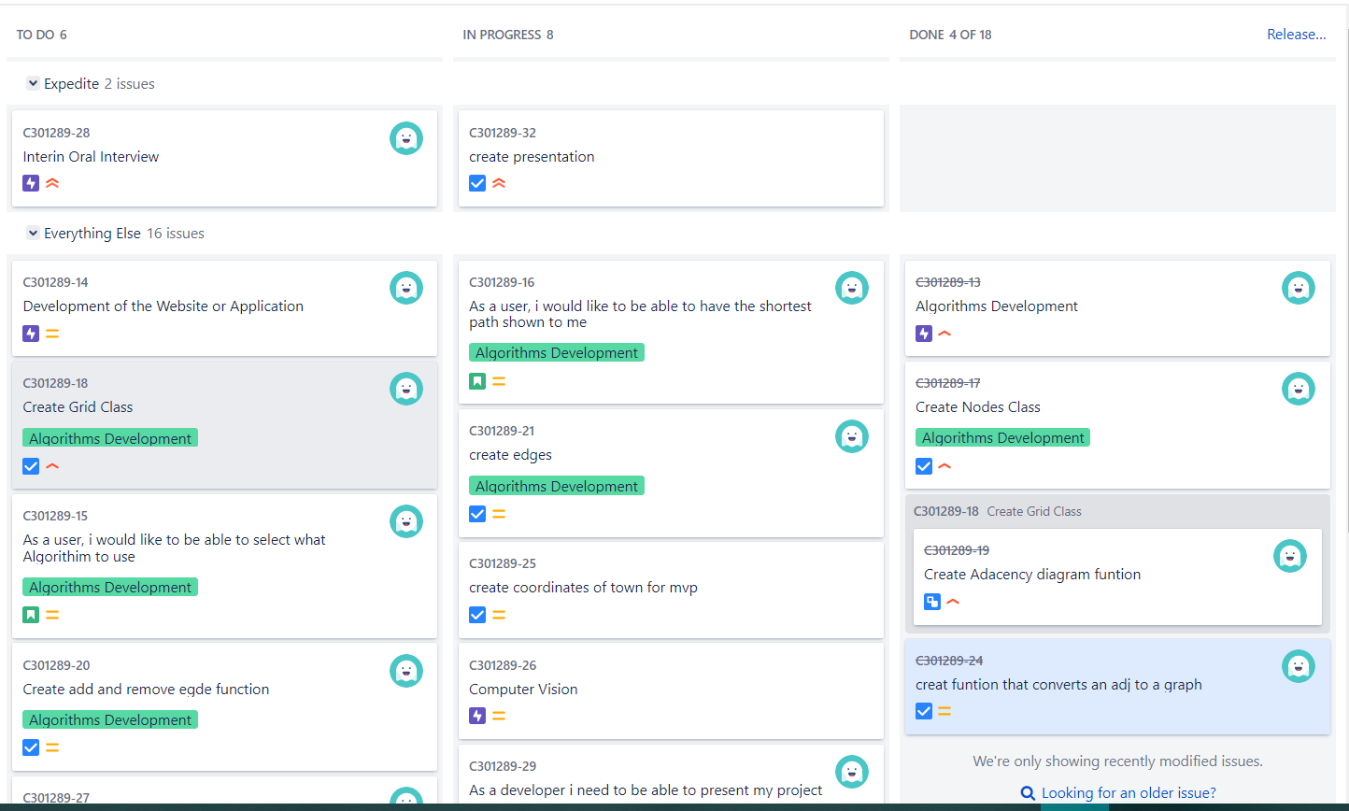
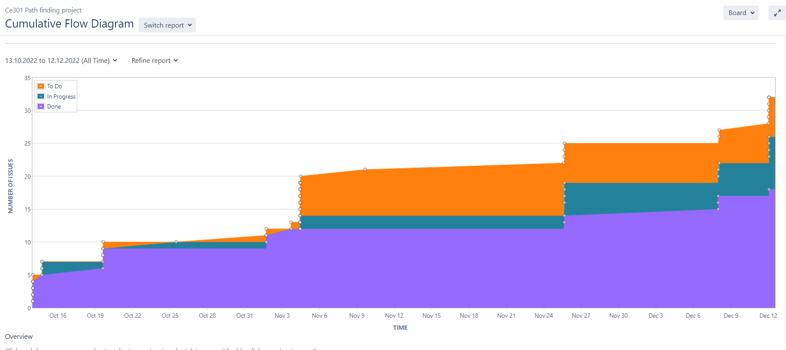
JIra
High Jira activity
Steady progress
Over 60 issues
All linked to commits on git lab

Slide 11

What the future holds
Move to integrate an interactive webpage
Add more points
Be able to calculate the distance of a map using computer vision (optmistic)
Clean up all bugs
Write up report
Create a poster

Slide 12

Thank You
For Listening!!

Slide 13


Project Title Here
Name and Supervisor here
Amino acids the building blocks of peptides and proteins and come in 21 varieties. There have been some initial studies using THz to probe amino acid structures and dynamics. However most of these studies use crystalline forms the amino acids crushed into a solid tablet form. This tablet in then probed with a range of THz frequencies from 0.1THz to 4THz. The experiments have been done for monomers and polymers for common amino acids.

Slide 14




Slide 15
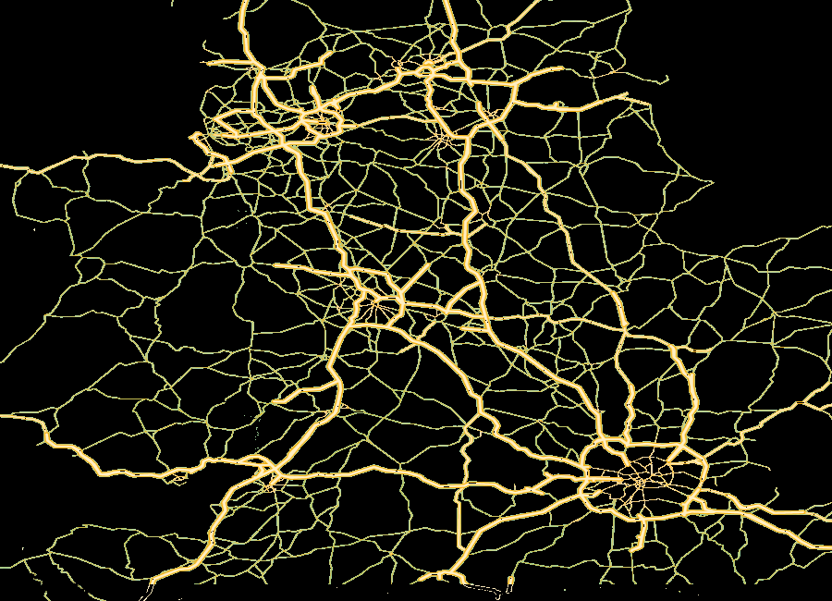
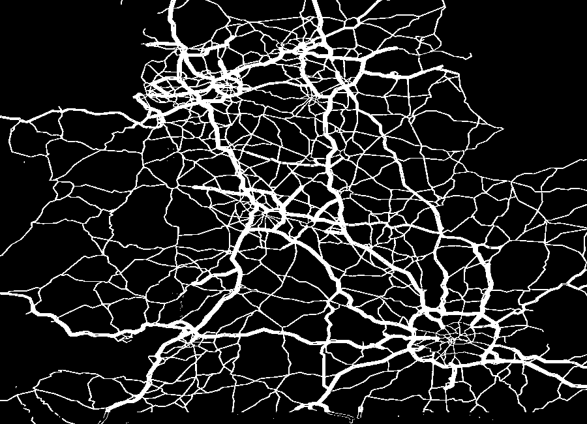
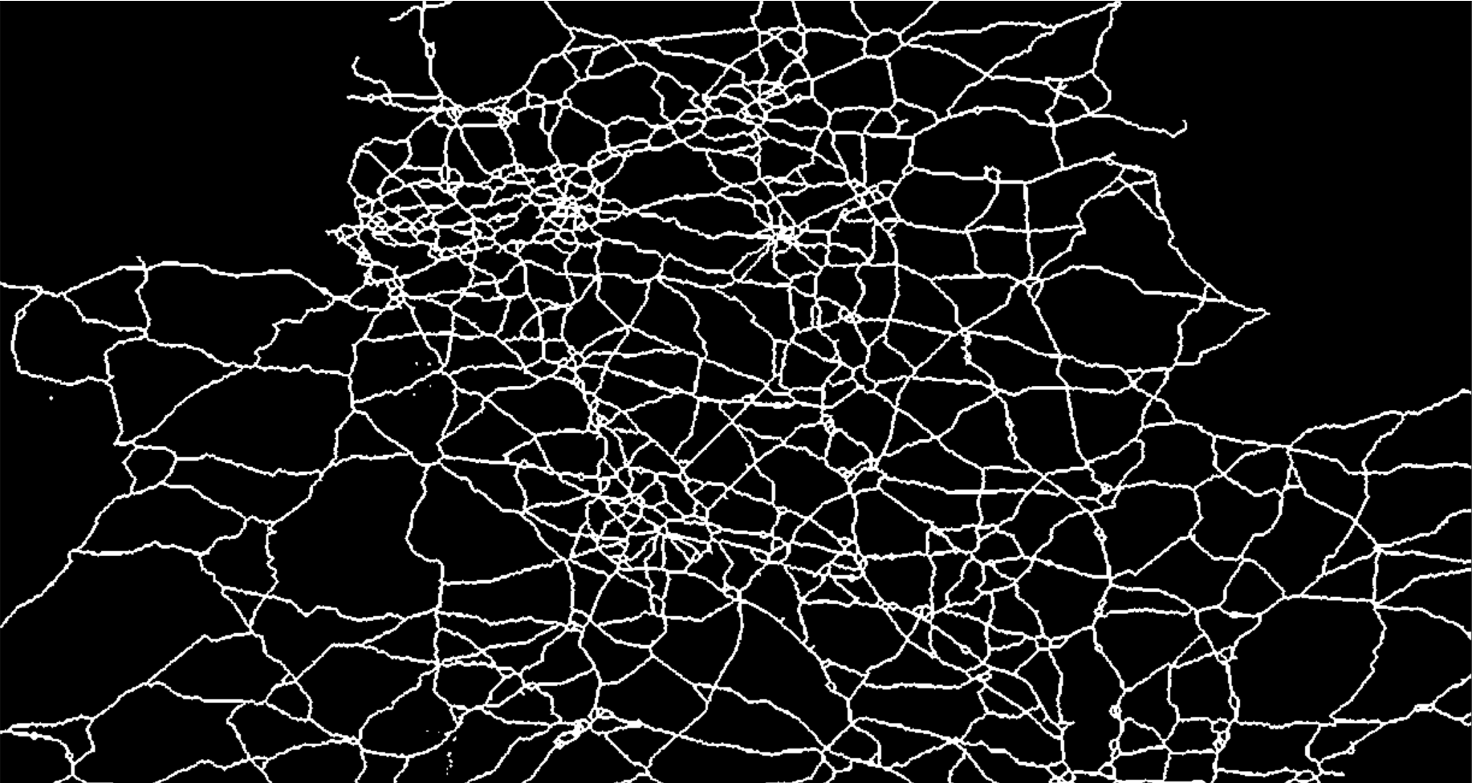
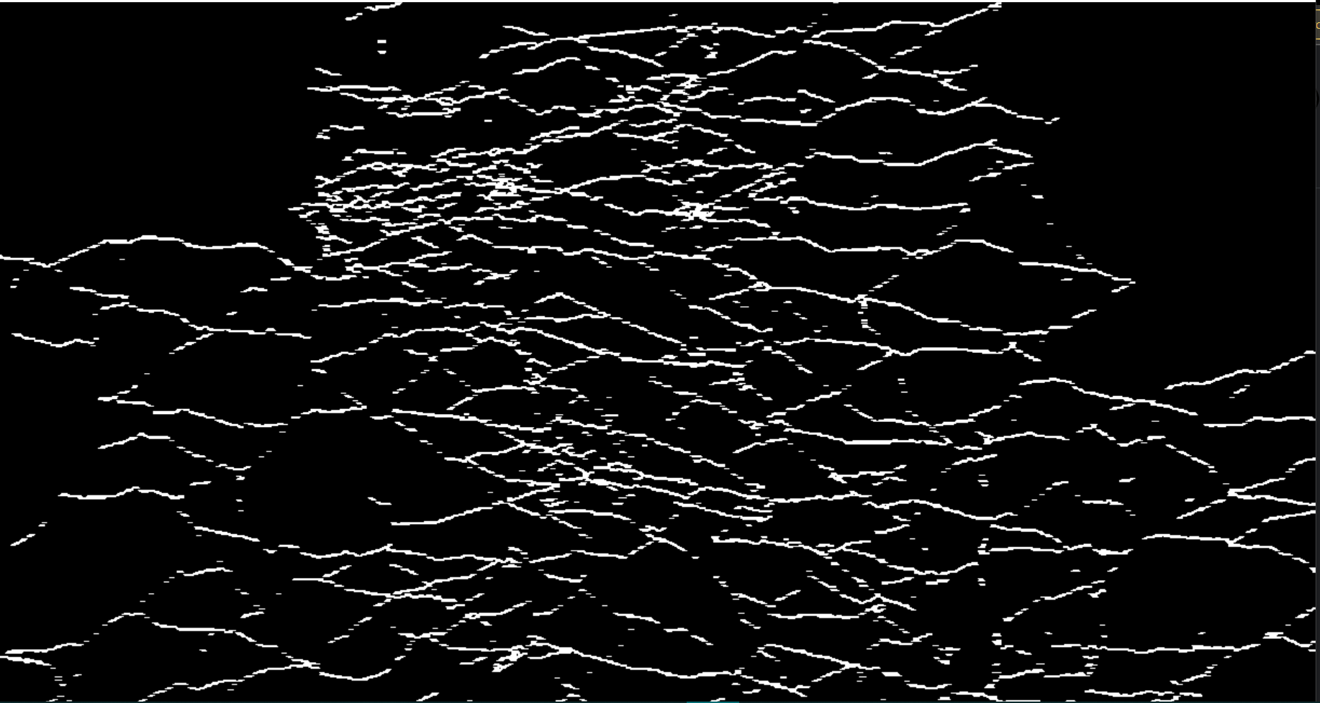
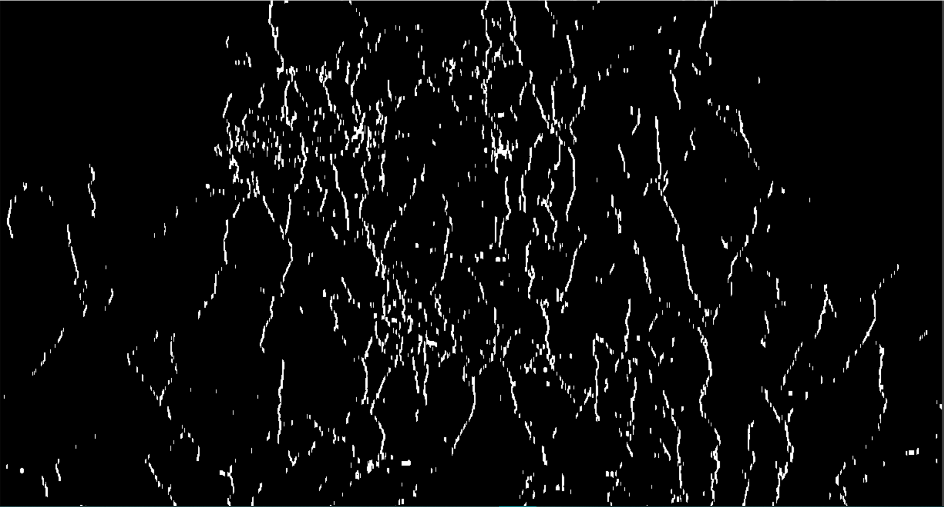
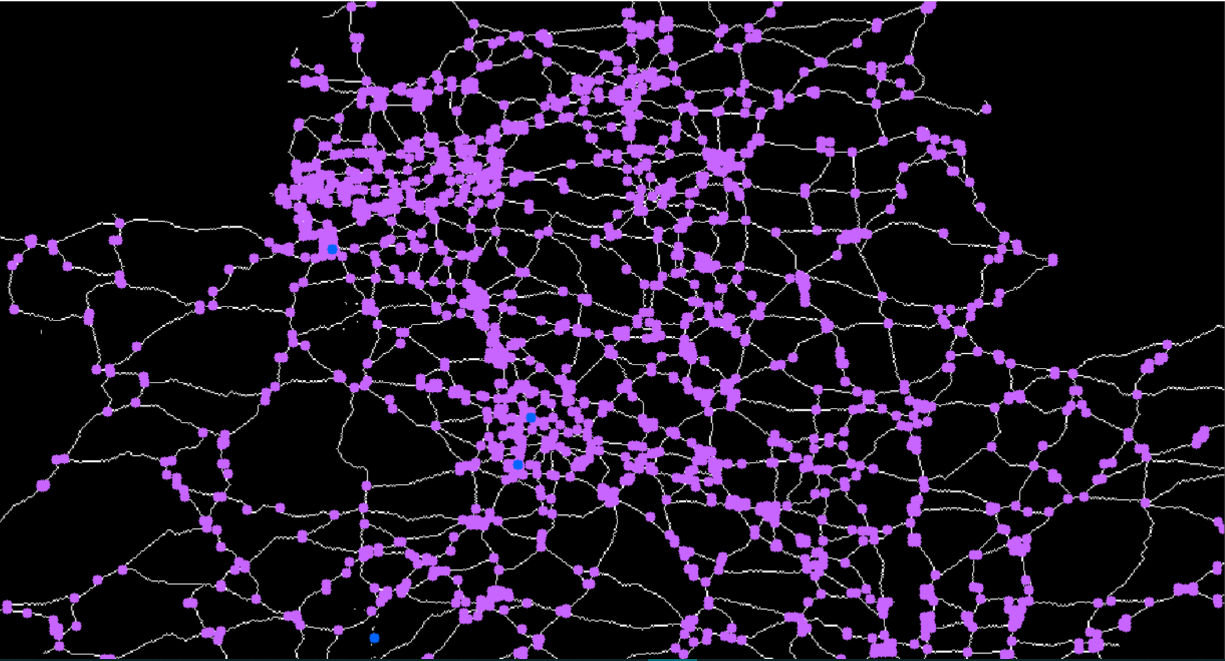


The Pathfinding Visualiser
Student: Emmanuel Olaoye Supervisor: Themistoklis Melissourgos
Introduction
This project is a computer vison tool that automatically reads the roads on a map to deliver the shortest path between two user entered destinations
User enters start and destination
The road is masked out and converted into a binary image
image is thinned into a 1-pixel-wide skeleton
Image is polarized into horizontal and vertical lines………
To form a neighborhood representation
To find the road intersections
To run Dijkstra's algorithm
To find the shortest path

